Slide 1
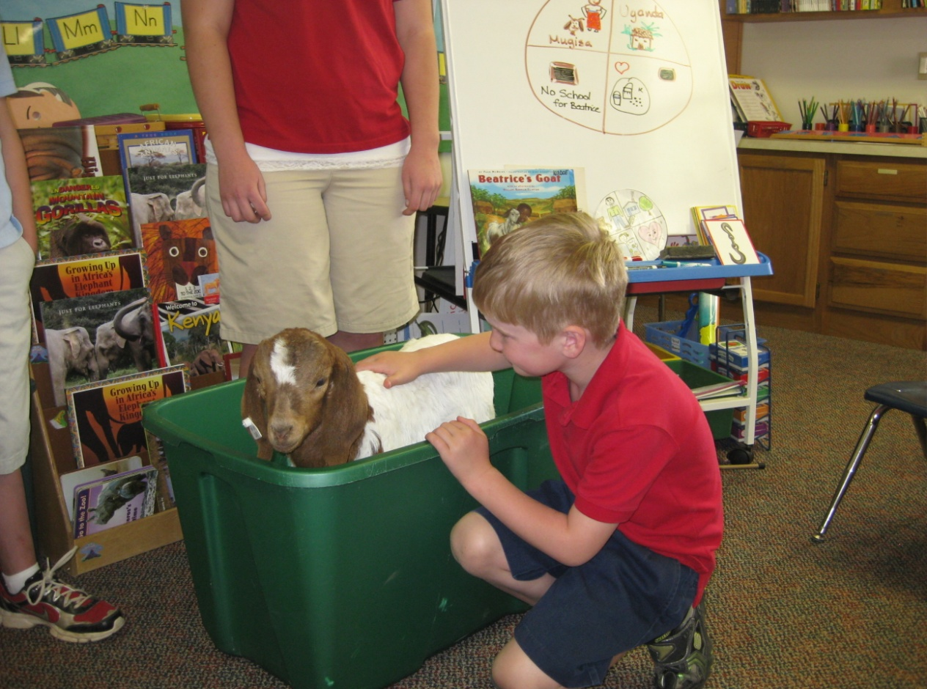
Welcome to the New NAD Kindergarten Stepping Stones A Journey to Excellence through Discovery

Slide 3
Description
The new NAD Kindergarten Stepping Stones program is based on the belief that kindergarten is a stepping stone between home, early childhood education, and the primary grades of school.
The program recognizes that young ones are created in God’s image and must be nurtured to think, learn, choose, and grow.
It is responsive to individual differences in developmental stage, ability, and interest.

Slide 4
Features of Stepping Stones
Strong spiritual connections – “Making the invisible God visible” is the primary goal
A comprehensive, integrated program that includes all subject areas
Rich children’s literature base
Themes aligned with elementary Pathways program
NAD Kindergarten Scope and Sequence target skills, covered in each theme book, are listed in the DLGs at the beginning of each theme book
Target skills are matched to specific activities

Slide 5
Features Meet Children’s Needs
Developmental program designed to meet each individual child’s needs
Inquiry-based activities which encourage exploration and discovery
Aligned with current research in all domains of development
General expectations of student learning are indicated in a grid at the beginning of each theme book under “Planning Overview”
Graphics in the grids indicate if target skills were just to be Presented, children should be Developing the skills, or it is expected most children will become Independent.

Slide 6
Correlates with Pathways’ Themes
Beginning School Off We Go!
Heroes Let’s Be Friends
My World and Others Who’s My Neighbor?
Living Things Deep in the Forest
Spiritual Journey Giving Gifts
Friends and Family We Are Family
Environment Brrrr! It’s Cold!
Growth & Feelings Wonderfully Made
Yesterday Moving On
Social Issues & Culture I’m on a Mission!

Slide 7
Spiritual Connections
Intro. Off We Go! God Loves Me
1. Let’s Be Friends God Gives Us Friends
2. Who’s My Neighbor? God Gives Me Everything I Need
3. Deep in the Forest God Made our World
4. Giving Gifts Jesus is God’s Best Gift
5. We Are Family God Gives Us Families
6. Brrrr! It’s Cold! Jesus Cares for Me
7. Wonderfully Made God Helps Me Make Good Choices
8. Moving On God Wants Us to Follow Him
9. I’m on a Mission! I can Share the Good News About Jesus

Slide 8
Components
Teacher Materials | Student Materials
Teacher Manual 10 Daily Lesson Guides and Blackline CDs 37 Trade Books 1 Resource Book 10 Bible Story Lap Books Bible Story/Music CD Stairway to Reading Kit (Phonics) | Kindergarten Bible Story Readers and CDs* Stairway to Reading Student Activity Book* *Consumable

Slide 9
DLGs | Week 1 |  | Week 2 |  | Week 3 |  | Week 4
Intro: Off We Go! | Hands as Warm as Toast |  | Nico and Lola
1. Let’s Be Friends | Bein’ With You this Way |  | Winners Never Quit |  | One Smile |  | This is Our House
2. Who’s My Neighbor? | Me On the Map |  | Adele & Simon |  | Be My Neighbor |  | Career Day
3. Deep in the Forest | When Rain Falls |  | Where Would I Be in an Evergreen Tree? |  | Good-Night, Owl! |  | When We Go Camping
4. Giving Gifts | Winter’s Gift |  | Christmas Day in the Morning |  | The Best Present
5. We are Family | Dad and Me in the Morning |  | Grandfather Counts |  | Sam and the Lucky Money |  | Mama Panya’s Pancakes
6. Brrrr! It’s Cold! | Balto |  | Mama , Do You Love Me? |  | Alaska Animal Babies |  | The Emperor’s Egg
7. Wonderfully Made | The Growing Story |  | The Busy Body Book |  |  |  | Happy , Healthy Me!
8. Moving On | Papa and the Pioneer Quilt |  | A Day on the Prairie |  | Iron Horses |  | Arbor Day Square
9. I’m on a Mission! | Jalapeño Bagels | A Box for Jairo |  | Beatrice’s Goat |  | Four Feet Two Sandals |  | Jungle Thorn

Slide 10
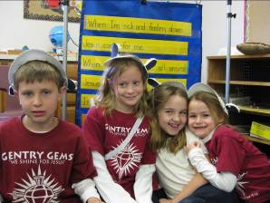
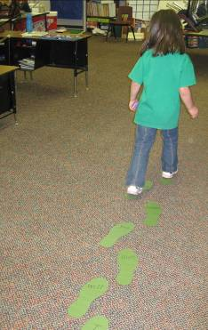
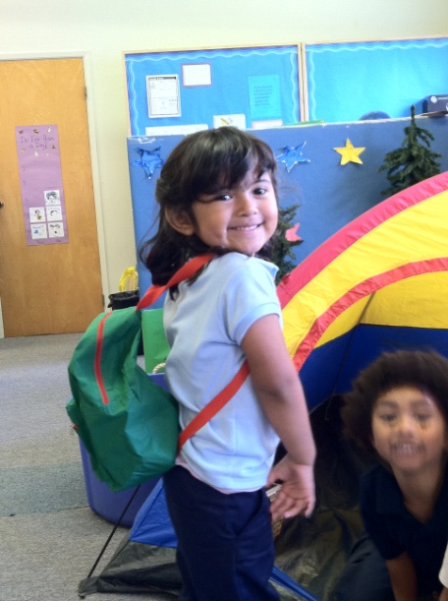
10 Instructional Blocks
Bible
Language Arts
Math
Science
Social Studies
PE
Art
Music
Dramatic Play
Technology

Slide 11
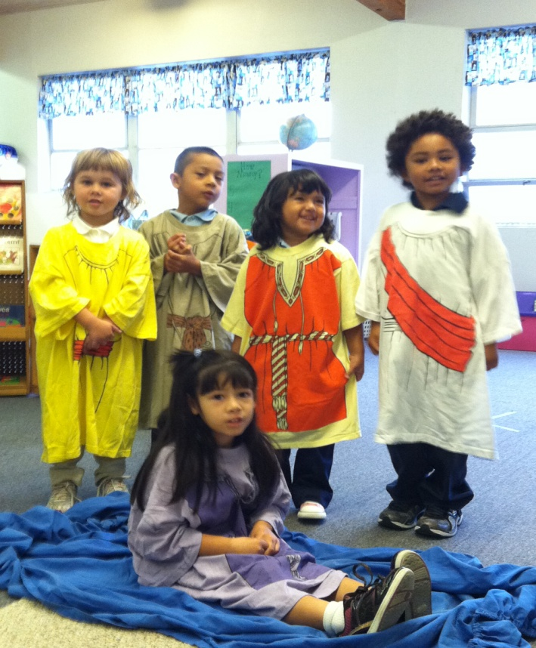
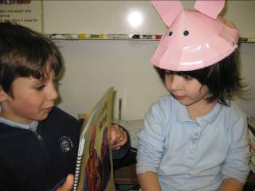
Suggested Schedule
Worship/Bible
Daily Routine
Singing/Theme Song
Daily Focus
(Suggestions in grids of DLGs)
Introducing
Presenting
Reviewing
Practicing
Applying
Bible Verse
Prayer

Slide 12
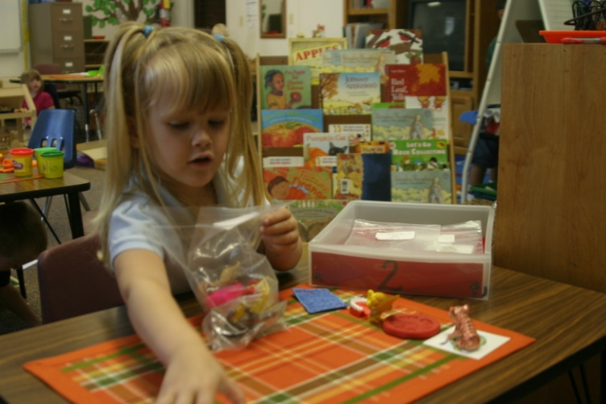
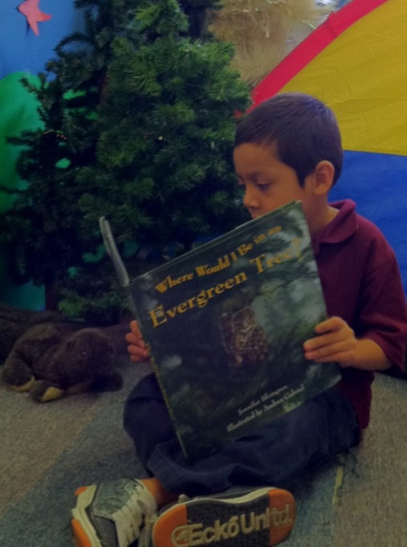
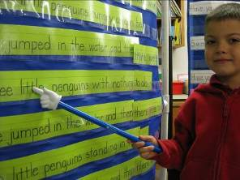
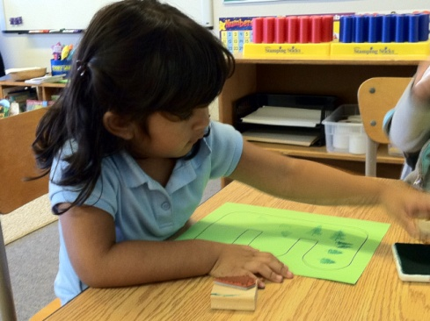
Suggested Schedule Continued
Language Arts
Daily Routine
Phonemic Awareness
Sound Letter Activities
Reading Workshop
Signing-In
Writing Workshop
Fine Motor Skills
Listening and Speaking
Stairway to Reading

Slide 13
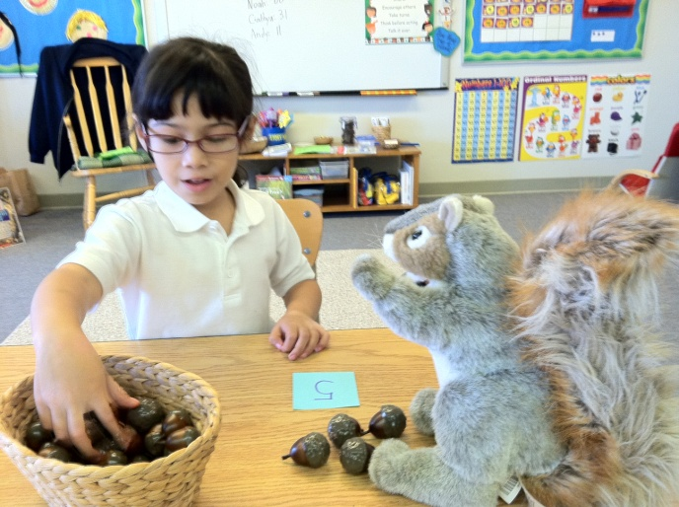
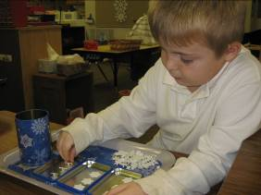
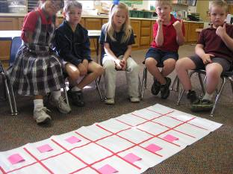
Suggested Schedule Continued
Math
Daily Routine
Large Group Work
Estimating /Predicting/Graphing
Calendar/Weather
Finger Plays/Poems
Small Group Work
Independent Work

Slide 14
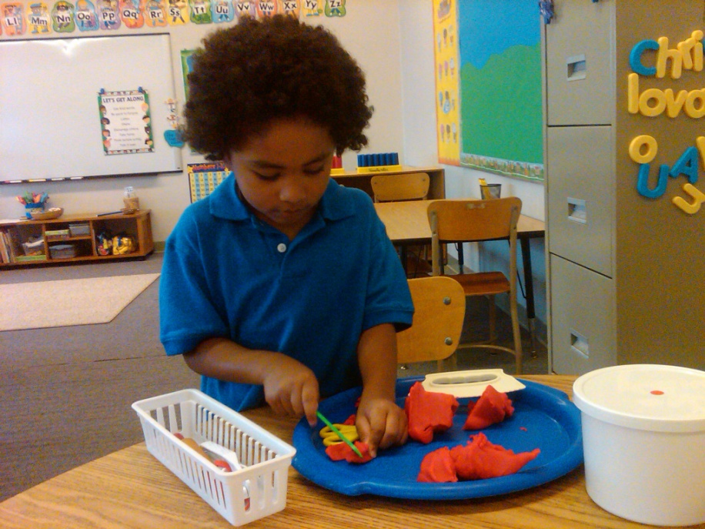
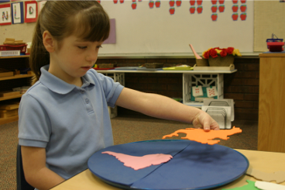
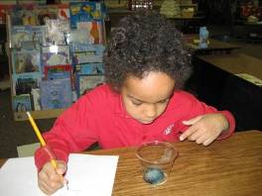
Suggested Schedule Continued
Science
Social Studies
PE
Art
Music
Dramatic Play
Technology

Slide 15
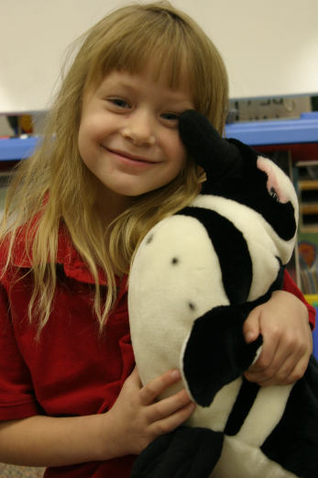
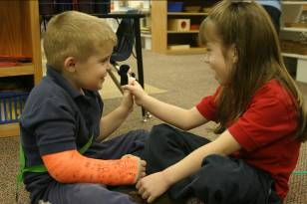
What Now?
Plan how to implement
Practice teaching strategies
Begin Kidwriting
Collecting books/resources on the 10 themes

Slide 16
Most Current Information
To join the Facebook group:
http://www.facebook.com/home.php#!/profile.php?id=1032933626
To check out our blog:
http://kindergartensteppingstones.blogspot.com/
NAD website
http:nadeducation.org

Slide 17
Other Supporting Resources
K-1, K-2 Multigrade planning resources for the classroom teacher (fall 2011) (http://pathways.nadeducation.org)
Webinars (to be scheduled by TDEC) (www.nadeducation.org/tdec)
Kendall/Hunt Website to order:
(www.kendallhunt.com/pathways/)

